Slide 1
Cross-Course
Cryptography
Chapter 3 – CEH
Chapter 8 – Sec +
CISSP

Slide 2
An Overview of Cryptography
Cryptography is a field almost as old as Humankind.
Cryptography is a “Pattern” (albeit, Complex):
  Nonmathematical Cryptography
    Substitution ciphers
      A type of coding or ciphering system that changes one Character or Symbol into Another
    Transposition ciphers (transportation code)
      Involves Transposing or Scrambling the Letters in a certain manner
  Mathematical
      Cryptography History Merges with
        First - Modern “Computing Machines”
        then Programmable Electronic Computers
    Based on Massively-Large Prime Numbers (in the most common case)
    Plotting the infinitely-changing points along an Elliptic Curve

Slide 3
Cryptography History Overview
Cryptography:
  Much older than “Computing Machines” or “Electronic Computers”
  “Secret Writing” - CONFIDENTIALITY
Hieroglyphs – “Encoded” Text
  Amusement / Entertainment more than Secrecy
Caesar Cipher - Secrecy
  Used to communicate with his Generals
  Shift characters by N positions in the Latin Alphabet
Arabia - Secrecy
  Substitution ciphers (~800 CE)
  Transposition ciphers (~ 1325)
England - Charles Babbage (1781-1871)
  Polyalphabetic ciphers (algorithm)
  Digital programmable computers first proposed
Germany - Enigma Machine (Invented WWI, Used WW II)
  Arthur Scherbius in 1918
    NOTE – this is where “Computer History” (as more modern) Intersects with the older Cryptography

Slide 4
Crypto & Computer History Intersect
Computer History
  Started with Mechanical Devices to solve “Complex” tasks:
    1801: In France, Joseph Marie Jacquard invents a Loom that uses punched wooden cards to automatically weave fabric designs
    1822: English mathematician Charles Babbage Conceives of a Steam-Driven Calculating Machine that would be able to compute tables of numbers
    U.S.-Herman Hollerith designs a Punch Card System to calculate the 1880 Census, accomplishing the task in just three years and saving the government $5 million. He establishes a company that would ultimately become IBM
      NOTE – by 1880 US Census took over 7 years to tabulate
    England - 1936: Alan Turing presents the notion of a Universal Machine, later called the Turing machine, capable of computing anything that is computable. The central concept of the modern computer was based on his ideas.

Slide 5
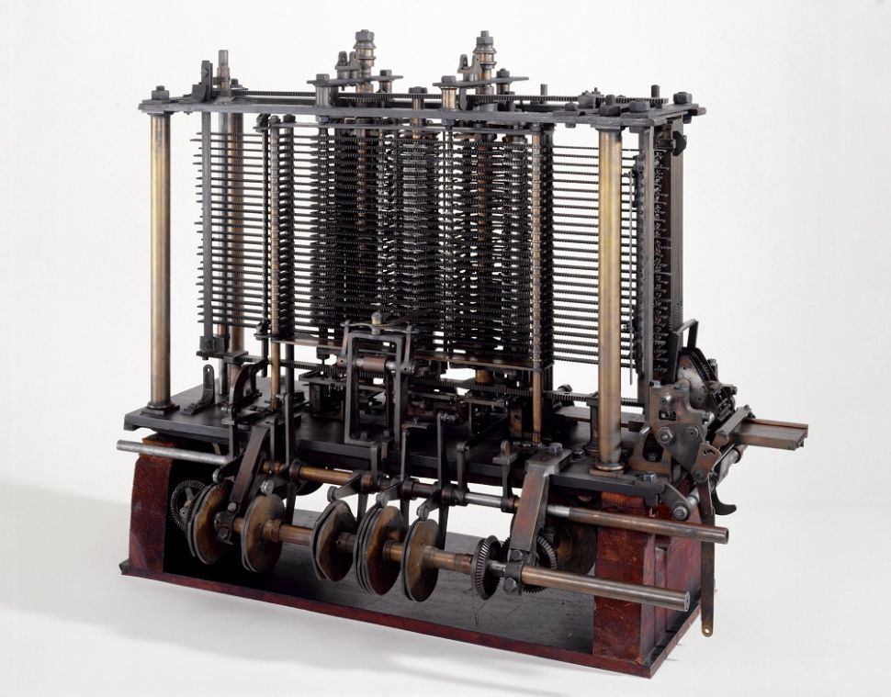
Charles Babbage – “Analytic Machine” - 1822
General Purpose Mechanical Computer – Design = Steam Powered

Slide 6
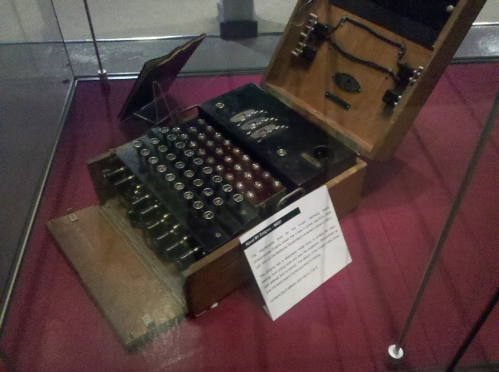
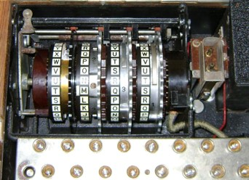
Enigma Machine…

Slide 7

Enigma Machine…

Slide 8
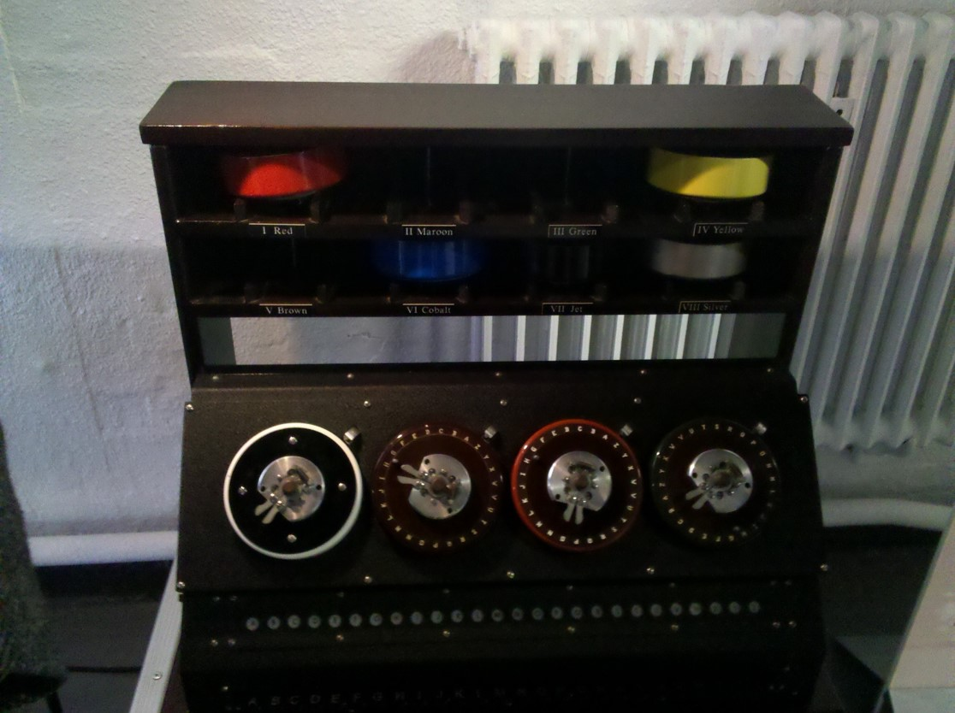
Enigma Machine Cogs

Slide 9
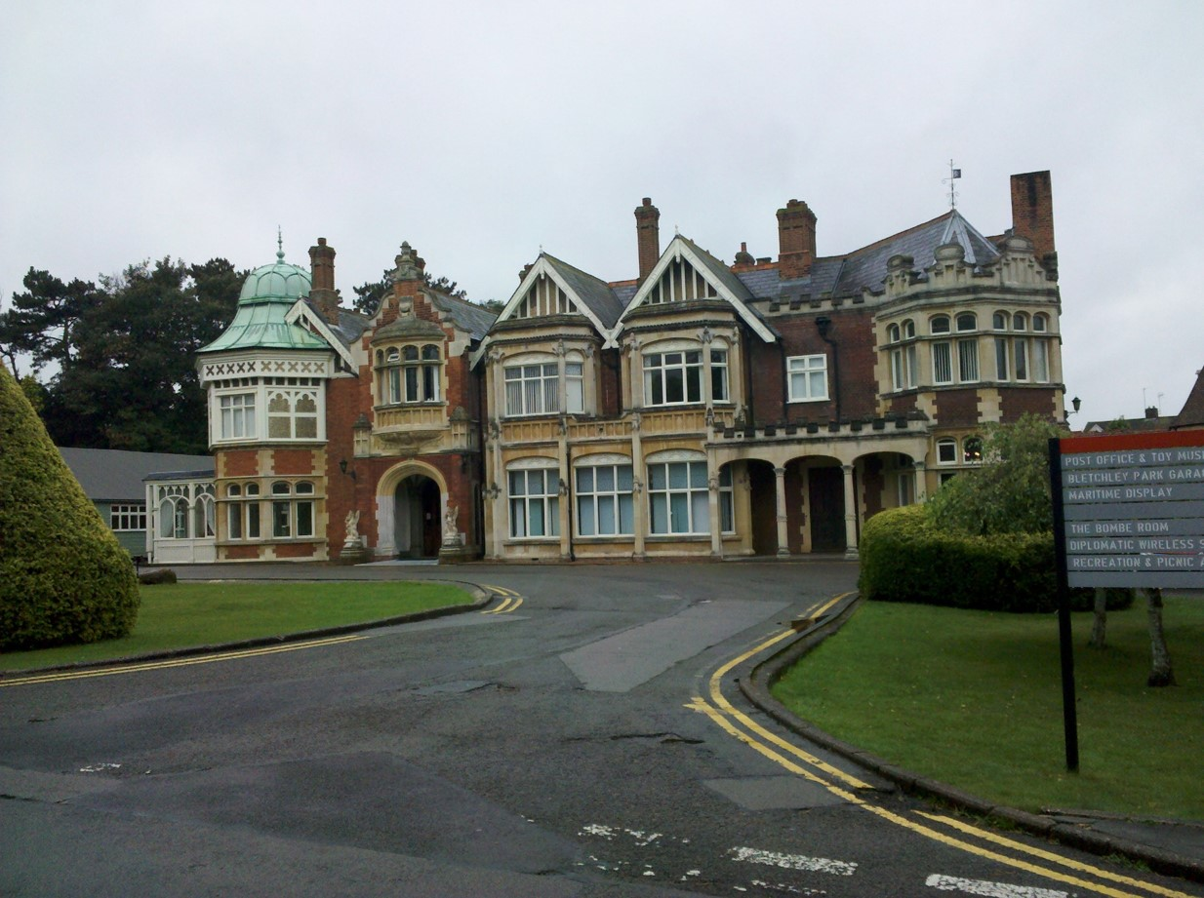
Bletchley Park

Slide 10
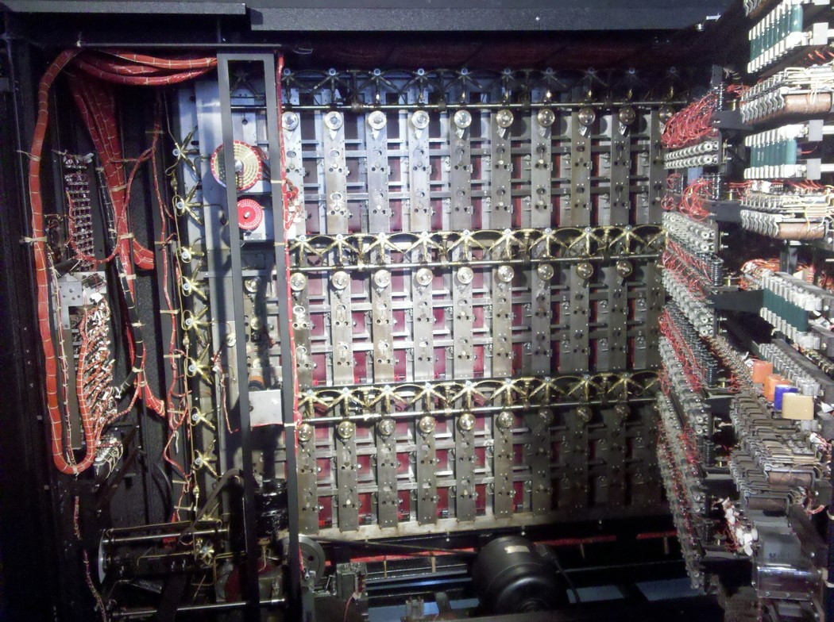
“The Bombe” by Turing (Lorenz Cipher)

Slide 11
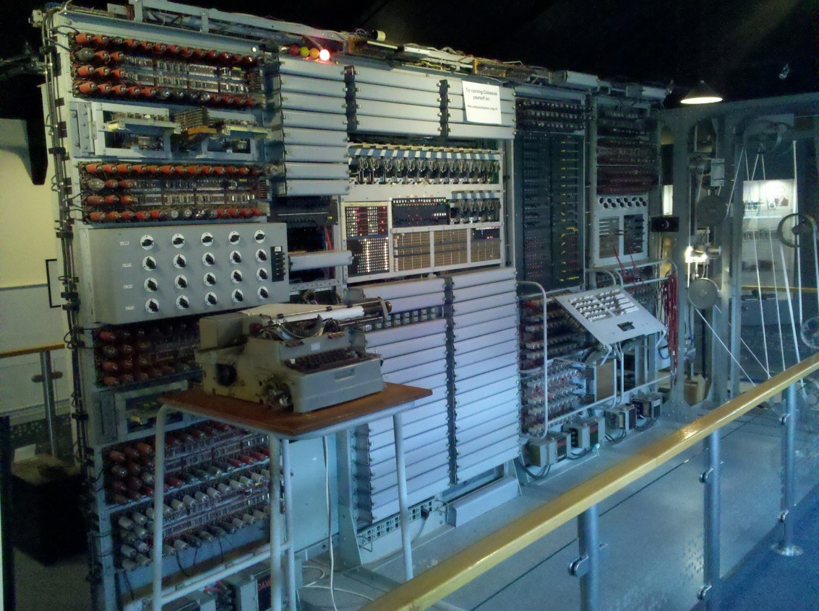
Colossus – Set of Computers

Slide 12
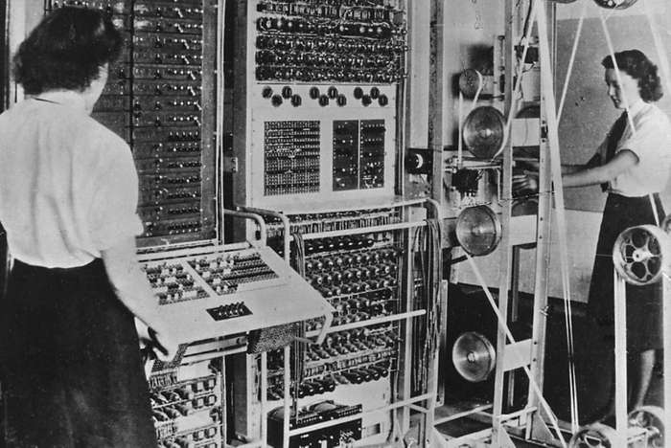
Colossus…

Slide 13
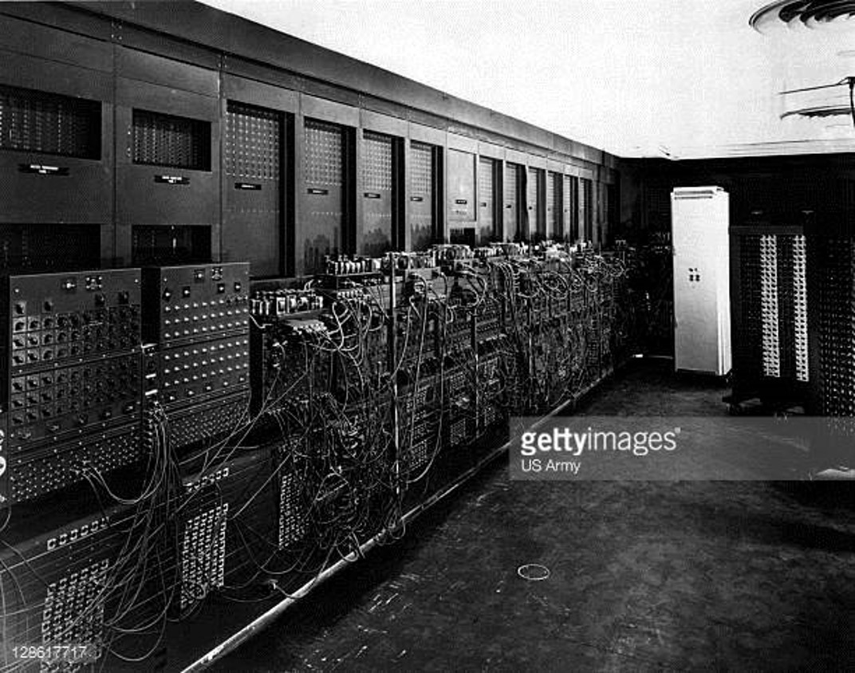
U.S. - Electronic Numerical Integrator and Computer
(ENIAC) – 2/15/1946 – Public Release
First “General Purpose” Electronic Programmable
Computer
NOTE – Colossus (1943 – 1945)
had limited counting and Boolean functions only (to focus on Crypto)

Slide 14
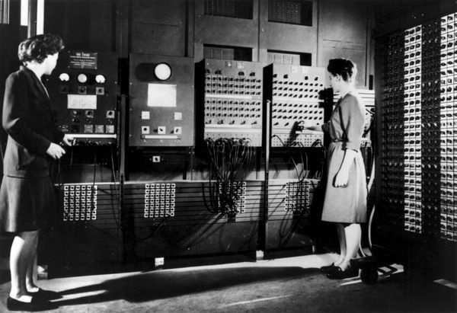
Frances Bilas (Spence) & Betty Jean Jennings (Bartik)

Slide 15
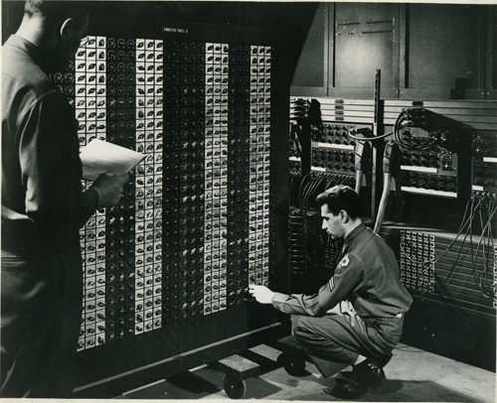
Function Table
1200, 10-way Switches-For Entering Tables of Numbers

Slide 16
Cryptography Terminology Review
Steganography
  The process of Hiding a message in a medium such as a digital image, audio file, or other file
    “OK” as a Basis, but requires Additional Security Mechanism
Hybrid systems
  Best when two or more of these methods of Nonmathematical Cryptography are Combined
Hashing
  Refers to performing a calculation on a message and converting it into a numeric hash value
    “Fingerprint” value for the input stream

Slide 17
2 Functional Crypto Types
Symmetric
  “Secret Key Crypto”, “Shared Secret”, “Private Key”
  Single, Shared Key is used
    Blowfish, Twofish, Data Encryption Standard (DES), 3DES and RC4, ECC
Asymmetric (has a LOT of RULES to make it work effectively)
  Key Pairs required
    One Key to Encrypt the “Opposite Key” to decrypt
    Mathematically related
  “Public Key Crypto”
    Public and Private (key pairs)
      To exacting standards…
      … into exactingly formatted and encrypted files (CERT)
      …. Using SERVICES (processes) that follow Industry STd rules.

Slide 18
2 Algorithmic Sub-Types
Block Cipher
  Fixed-length blocks of data …
  … disregarding Input Data-Type Boundaries
    DES – Data Encryption Std.
      3 DES
    IDEA International Data Encryption Algo. (Swiss, 1991)
    RC5
    Rijndael / AES
    Blowfish
Stream Cipher
  RC4 - 1994
    Ron’s Cipher (Ron Rivest of RSA corp)
      Key Size = 40 – 2048 bits
  AlanTuring
    Figured out the Math involved in the Electro-Mechanical Enigma Model (Substitution + Transposition)

Slide 19
Goals of Cryptography
Confidentiality
Integrity
Nonrepudiation
Authentication
Goals

Slide 20
Understanding Cryptography
Legal issues
Financial compliance
Healthcare regulations
Defense industries
Acceptable Algorithms
Key Strengths
  Kerckhoff’s Principle:
    Netherlands born cryptographer Auguste Kerckhoffs in the 19th Century:
      A cryptosystem should be secure even if everything about the system, EXCEPT the KEY, is public knowledge
      Generally – longer = better

Slide 21
What Is Cryptography?
Protects information
Way of blocking threats to secrecy
Preserves the state of information
A constantly evolving body of knowledge
What does it do?
As information has changed and human beings have gotten smarter, the technology has become substantially more advanced to keep up with changing issues and threats.

Slide 22
Hieroglyphics as an Example
Intricate patterns and glyphs used in Egyptian hieroglyphics were commonly used for spiritual and religious reasons.
Egyptian hieroglyphics had Spiritual and Religious significance
Not designed to preserve secrets
Used to commune with other world
Usage restricted to royal family and religious orders
Could not be deciphered again until 1799 and discovery of Rosetta Stone

Slide 23
Modern Applications of Cryptography
Cryptography has even made some of the everyday technologies that you use possible.
E-commerce applications
Couldn’t exist in current form without cryptography
Provides Secrecy, Integrity, and Authentication
Mobile technologies
Prevents identity theft
Stops device duplications
Prevents eavesdropping

Slide 24
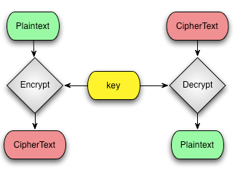
Important Terms and How They Work
Plaintext or Cleartext
Ciphertext
Algorithms
Keys

Slide 25
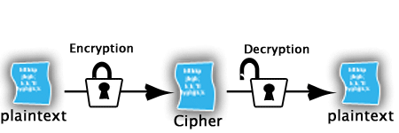
Introducing Symmetric Cryptography
All algorithms that fit into the symmetric variety use a single key to both encrypt and decrypt (hence the name symmetric).
Symmetric systems are great at
Confidentiality
Speed
Overall Simplicity
Providing Authenticity
Drawbacks of symmetric systems
Key Management
Lack of Non-Repudiation Capability
No Automated Secure Key Exchange Mechanism

Slide 26
Examples of Symmetric Algorithms
There are currently a myriad of symmetric algorithms available; a Google search turns up an endless sea of alphabet soup of algorithms.
Data Encryption Standard (DES)
Triple DES (3DES)
Blowfish
International Data Encryption Algorithm (IDEA)
RC2, RC4, RC5, RC6
Rijndael or Advanced Encryption Standard (AES)
Twofish

Slide 27
Working with Symmetric Algorithms
Symmetric Algorithms
  Require Both Ends of an encrypted message to have the Same Key and processing Algorithms.
  Faster encryption than Asymmetric (by a factor of thousands)
  Less “Load” on the Computer
Some Common Standards that use Symmetric Algorithms:
  Data Encryption Standard (DES)
    64 Bit Blocks, Original Key Strength (Length) = 48 Bits
    {Old – don’t use it}
  Triple-DES (3DES)
    3 successive encryption rounds with 3 different 56 bit Keys
    Very Slow
  Advanced Encryption Standard (AES) ~ 2001
    Symmetric Cipher
    Block Cipher
    Algorithm originally, “Rijindael”
    NIST 2001
      FIPS PUB 197 & ISO/IEC 18033-3
    Different Key and Block Sizes
      128,192,256, 512

Slide 28
Asymmetric or Public Key Cryptography
The concept of public key cryptography was intended to overcome key management problems in previous systems. In the system each user receives a pair of keys called the public key and the private key. Each person’s public key is published, whereas the private key is kept secret.
Uses a Key Pair consisting of a Public Key and a Private Key
Adds Non-Repudiation
Can enforce Authentication
Solves Key Management , Including Secure Key Exchange
Is Slower compared to symmetric systems

Slide 29
Asymmetric Encryption
Encryption
Hello
Algorithm
$%@@!
Key 1
Decryption
$%@@!
Algorithm
Hello
Key 2

Slide 30
Working with Asymmetric Algorithms
Asymmetric algorithms use Two Keys to encrypt and decrypt data.
  Public key
    May 2017 = from 1024 bits -> 2048
  Private key
    May 2017 = from 2048 bits = 4096 bits
    {Key Pairs – the 2 keys are Related Mathematically}
  Noticeably slower because:
    Keys are MUCH Bigger than Symmetric methods
    Algorithms (ciphers) are far more complex than Sym.
    2 keys are involved in the “overall process”

Slide 31
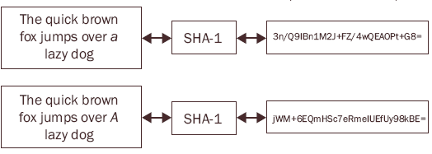
About That Hash
A Hash is a One-Way Function
Can be computed in One Direction but Not The Other
Is a Fixed Length
Creates a Unique Output For Every Input (“fingerprint”)

Slide 32
Hashing Algorithms
Hashing is used to detect changes in information: anything that is hashed and then changed, even a small amount, will result in an entirely different hash from the original.
Message Digest 2 (MD2)
Message Digest 4 (MD4)
Message Digest 5 (MD5)
Message Digest 6 (MD6)
HAVAL ~1992, differing Hash Lengths, Broken ~ 2004
RIPE-MD, Family of Hash F(x)s, ~1991, used by Bitcoin
Secure Hash Algorithm-0 (SHA-0)
Secure Hash Algorithm-1 (SHA-1)
Secure Hash Algorithm-2 (SHA-2) { now Version 3}

Slide 33
Hashing in Digital Signatures -Process
Sean creates a Message.
Sean Hashes the message.
Sean Encrypts the Hash with his Private Key.
Sean Sends the Combination to Zelda.
Zelda sees that the message came from Sean.
Seeing who the sender is, Zelda Retrieves Sean’s Public Key.
Zelda reruns the algorithm against the plaintext and compares the two.
If the hashes match, the message has not been altered.
Zelda Decrypts the Hash value, thus validating the identity of the sender.

Slide 34
The Role of Digital Certificates
A digital certificate complements or replaces other forms of authentication. A user who presents the credential must have a method in place that allows for the credential to be validated.
Digital Certificates establish Ownership of a Key
Can be attached to a Person, Computer, or Service, Company
Certificates are issued under Specific Rules ( PKCS -> PKI)
Used in many applications such as E-Commerce

Slide 35
Certificates
Primary Method of Identifying that a given User is Valid
Store Authorization Information
Verify or Certify that a System is Using the Correct Software and Processes to Communicate Securely

Slide 36
Certificates …
Certificate Policies:
  Define “What” Certificates do
    What Subset of functions are supported
Certificate practice statement (CPS)
  A Detailed Statement the CA uses to issue Certificates and implement its Policies

Slide 37
Certificate Revocation
Certificate Revocation
  The process of revoking a certificate before it expires
Certificate Revocation List (CRL)
Online Certificate Status Protocol (OCSP)
Repository
  A database or database server where the certificates are stored

Slide 38
Cryptographic System
A Cryptographic System is a system, method, or process that is used to provide Encryption and Decryption, in a CONTROLED (Managed) Environment
  Confidentiality and strength
  Integrity
  Digital signatures
    Guaranteed Identity
  Authentication
  Nonrepudiation

Slide 39
Public Key Standards
X.509 – Certificates:
  Certificate Formats and Fields for Public Keys
  Procedures that should be used to Distribute Public Keys
Public-Key Infrastructure X.509 (PKIX)
  The working group formed by the IETF to develop standards and models for the PKI environment
Public-Key Cryptography Standards (PKCS)
  A set of voluntary standards created by RSA and security leaders

Slide 40
Public Key Infrastructure (PKI)
Public Key Infrastructure (PKI):
  Intended to provide a means of providing security to messages and transactions on a grand scale
PKI is a Two-Key, Asymmetric system with Four main components:
  Certificate authority (CA)
    issuing, revoking, and distributing certificates
  Registration authority (RA):
    distribute keys, accept registrations for the CA, and validate identities
      Optional – LRA:
        identify or establish the identity of an individual for certificate issuance
  RSA (the encryption algorithm)
  Digital Certificates

Slide 41
Certification Authorities
A Certification Authority (CA) handles digital Certificates.
A CA can Revoke a Certificate.
A CA will Validate a Certificate.
“Trusted Third Party” is a name used to describe a CA.

Slide 42
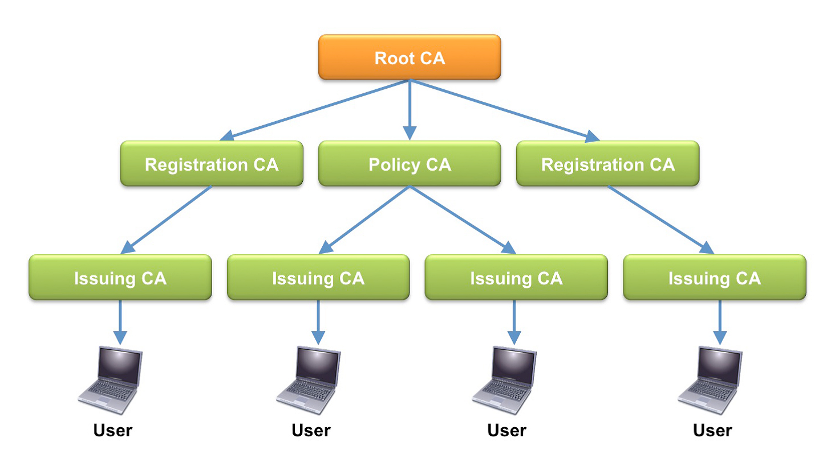
Building a PKI System

Slide 43
PKI Trust Models
Four main types of trust models are used with PKI.
  Hierarchical
  Bridge
  Mesh
  Hybrid

Slide 44
Trust Models…
Hierarchical Trust Model
  Also known as a tree; a root CA at the top provides all the information
Bridge Trust Model
A peer-to-peer relationship exists between the root CAs
Mesh Trust Model
  Expands the concepts of the bridge model by supporting multiple paths and multiple root CAs
Hybrid Trust Model
  Can use the capabilities of any or all of the structures discussed in the previous sections

Slide 45
Applications of Cryptography: IPSec
Internet Protocol Security (IPSec) protects data during transmission
Operates at the Network Layer
Very widely used
Present in Virtual Private Networks (VPN)

Slide 46
Applications of Cryptography: PGP
Designed to provide security in online communications
Similar to Public and Private Key Encryption
Is used to both Sign and Encrypt communications
Can be used to protect data files on hard drive or other media

Slide 47
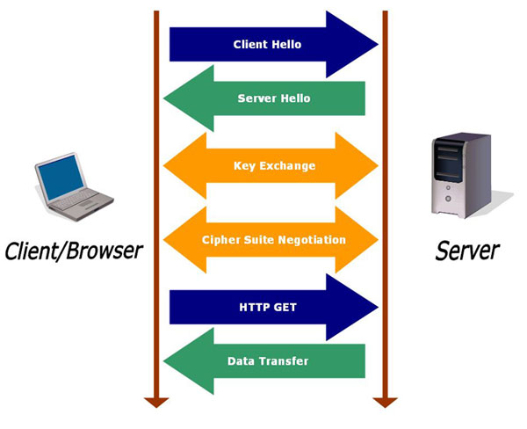
Applications of Cryptography: Secure Sockets Layer
L5 & 6
Developed by Netscape in 1990s
Standard for exchanging secure data
Encrypts information prior to transmission
Decrypts upon receipt
Combines asymmetric and symmetric systems

Slide 48
Applications of Cryptography
Certificate Management Protocol (CMP)
  A messaging protocol used between PKI entities
Secure Multipurpose Internet Mail Extensions (S/MIME)
  A standard used for encrypting e-mail
Pretty Good Privacy (PGP)
  A freeware e‑mail encryption system
Hypertext Transport Protocol over SSL (HTTPS):
  Authenticates Server BUT NOT Client (as a default)
Secure Hypertext Transport Protocol (S-HTTP):
  more advanced version of HTTP that provides:
    security through encryption
    Client and Server (Cross) Authentication
IP Security (IPSec)

Slide 49
Applications of Cryptography
Tunneling protocols
  Adds a capability to the network
  Common protocols used for tunneling
    Point-to-Point Tunneling Protocol (PPTP)
    Layer 2 Forwarding (L2F)
    Tunneling Protocol (L2TP)
    Popular Protocols for VPN:
      L2TP + EAP (usually EAPOL) + IPSEC)
Federal Information Processing Standard (FIPS)
  A set of guidelines for the United States federal government information systems

Slide 50
Code-breaking Techniques
Frequency Analysis
  involves looking at blocks of an encrypted message to determine if any Common Patterns exist.
Algorithm Errors
  is a method or set of instructions used to perform a task or instruction.
Brute-force Attacks
  can be accomplished by applying every possible combination of characters that could be the key
  Guaranteed Successful (over time)
  Slowest Technique
Exploiting Human Error
  Human error is one of the major causes of encryption vulnerabilities.
Rainbow Tables
  a precomputed table for reversing cryptographic hash functions, usually for cracking Password Hashes

Slide 51
Industry Associations and the Developmental Process
The need for security in specific industries, such as the banking industry, has driven the development of standards.
American Bankers Association (ABA)
Internet Engineering Task Force (IETF)
Internet Society (ISOC)
World Wide Web Consortium (W3C)
International Telecommunications Union (ITU)
Institute of Electrical and Electronics Engineers (IEEE)
Public Domain Cryptography
  Pretty Good Privacy (PGP) – Open source and free
  GPG
    GNU Privacy Guard

Slide 52
Some Standards to Know
PII
  Personally Identifiable Information
PCI
  Payment Card Industry
HIPAA
  Health Insurance Portability & Accountability Act
FIPS
  Federal Information Processing Standards

Slide 53
Summary
Understanding cryptography is important to progressing into pen testing.
Cryptography keeps data and services safe.
Cryptography provides confidentiality, integrity, non-repudiation, and authentication services.
Technologies such as SSL, IPSec and others would not be possible without cryptography.

